Slide 1

AIMS: An Internet Media Store
IT4549E ITSS Software Development

Slide 2
INTRODUCTION
Scope
The AIMS Project is a desktop e-commerce software designed to facilitate the buying and selling of media products such as books, CDs, LP records, and DVDs.
Users: browse, search for, and purchase various media items seamlessly.
Administrators: manage users
Product managers: manage and make changes to products
Glossary
Some vocabularies: CRUD operations, Downtime, Response time, … are provided in the Software Design Document.

Slide 3
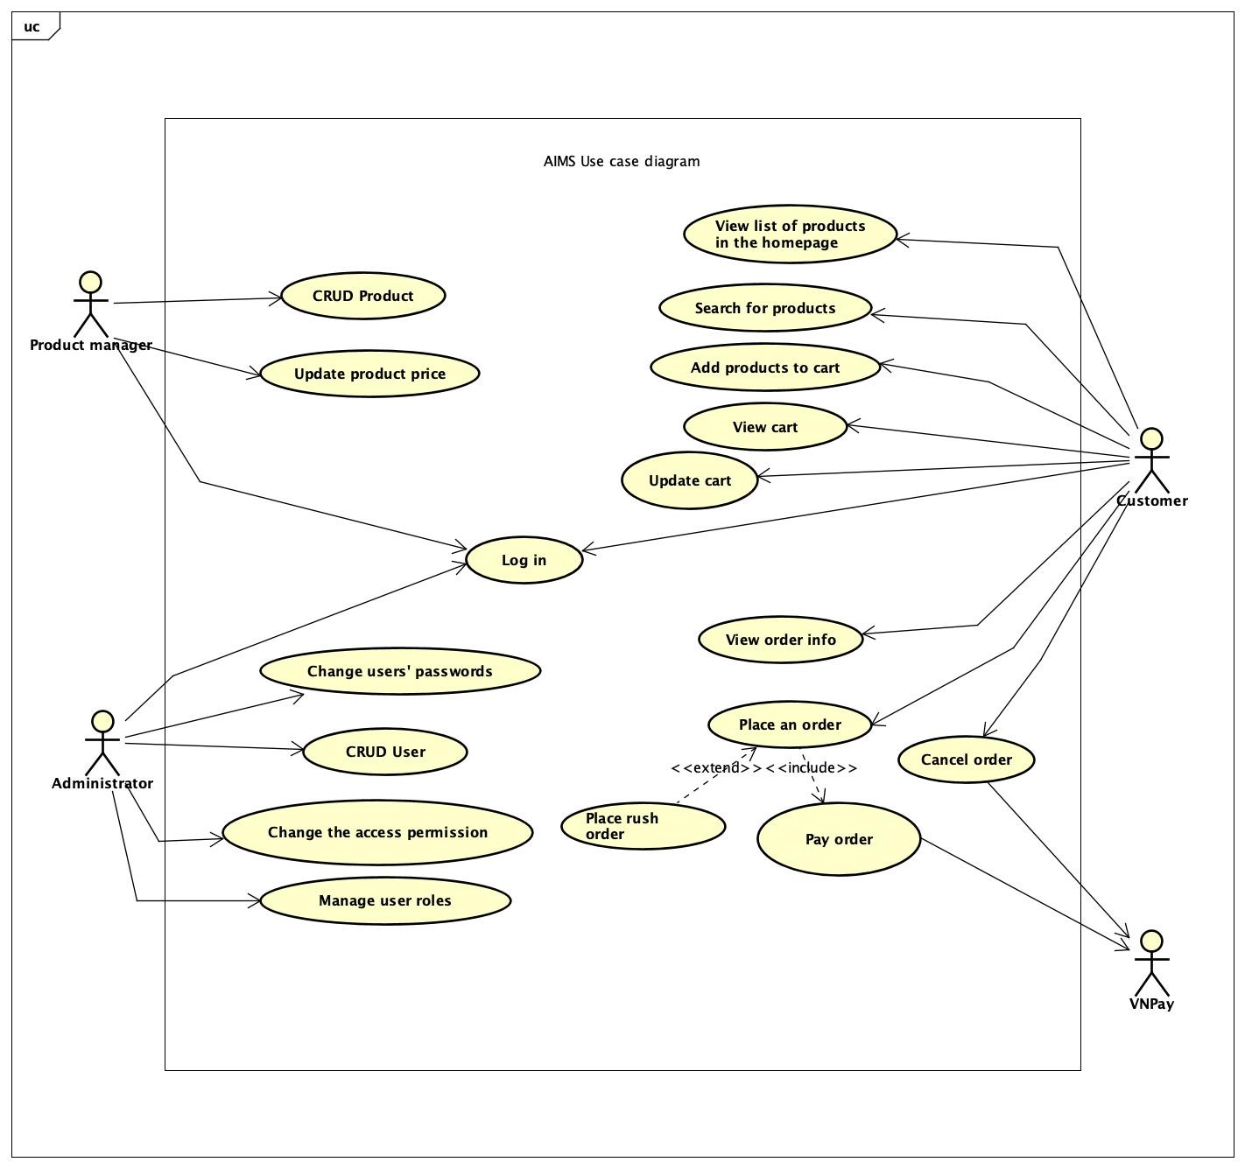
OVERALL DESCRIPTION
General overview

Slide 4
OVERALL DESCRIPTION
2. Assumptions/Constraints/Risks
Assumptions
A Java-based application, will run on standard desktop operating systems, including Windows and macOS.
Users will have a basic understanding of e-commerce platforms and digital transactions.
The system will rely on VNPay for payment processing, assuming VNPay's API remains stable and well-documented.

Slide 5
2. Assumptions/Constraints/Risks
b. Constraints
Hardware/Software Environment
End-User Environment
…
c. Risks
System Performance: Degraded performance if user load exceeds 1,000 simultaneous users
Data Security: Data breaches could compromise user information

Slide 6
SYSTEM ARCHITECTURE & ARCHITECTURE DESIGN
1. Architectural Patterns
The AIMS Project employs a 3-tier architecture, which is a well-established architectural pattern that separates the application into three distinct layers:
The presentation layer
The business logic layer
The data layer

Slide 7
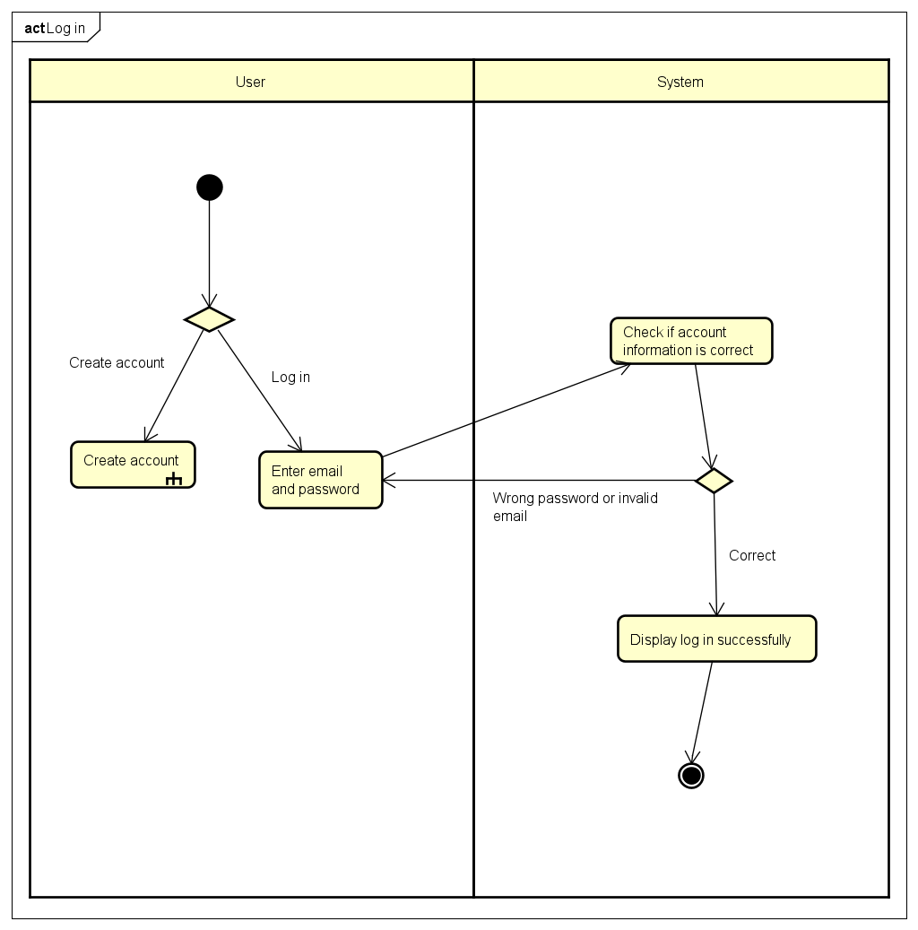
SYSTEM ARCHITECTURE & ARCHITECTURE DESIGN
2. Interaction Diagram:
Log in

Slide 8
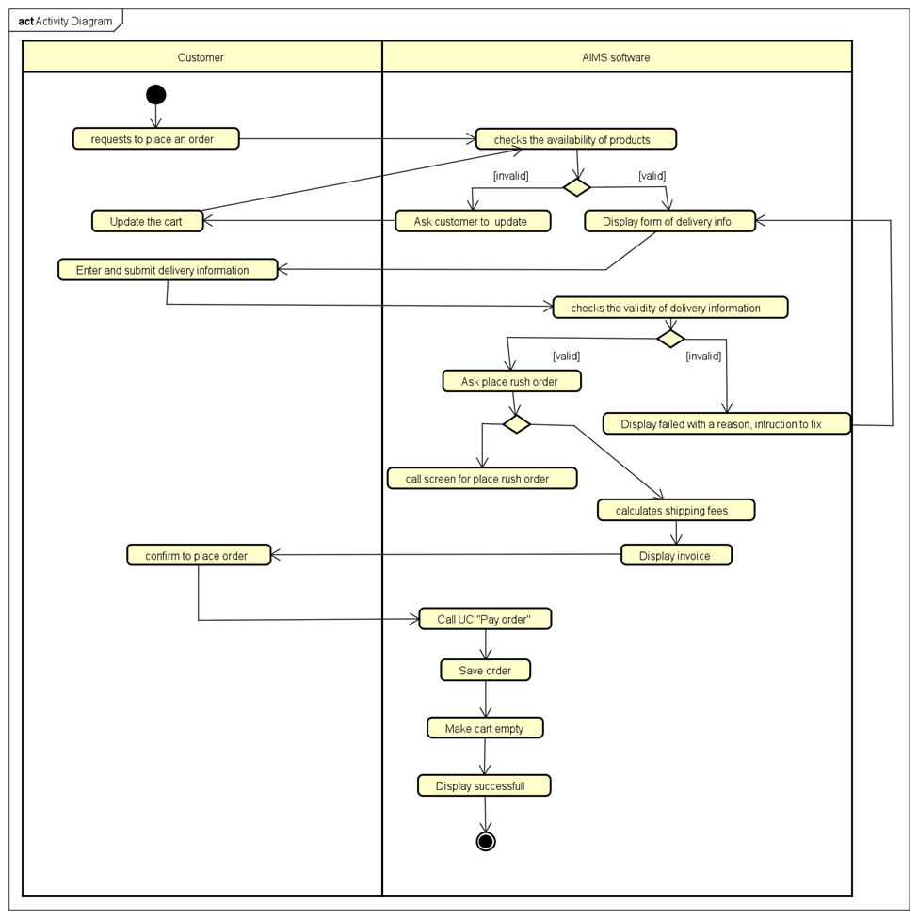
SYSTEM ARCHITECTURE & ARCHITECTURE DESIGN
2. Interaction Diagram:
b) Place order

Slide 9
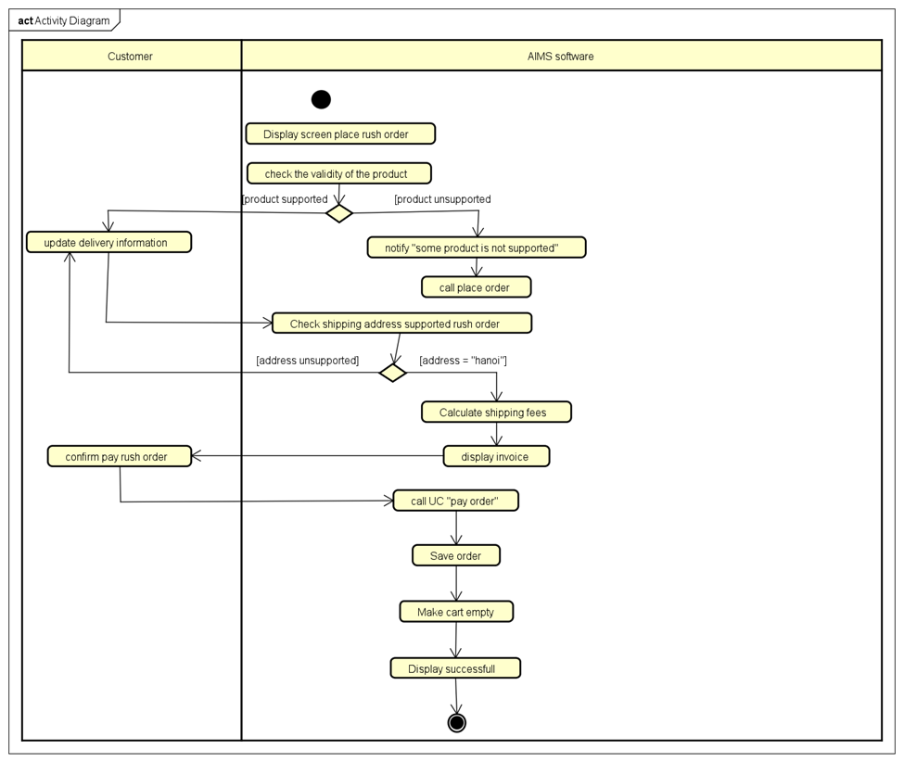
SYSTEM ARCHITECTURE & ARCHITECTURE DESIGN
2. Interaction Diagram:
c) Place rush order

Slide 10
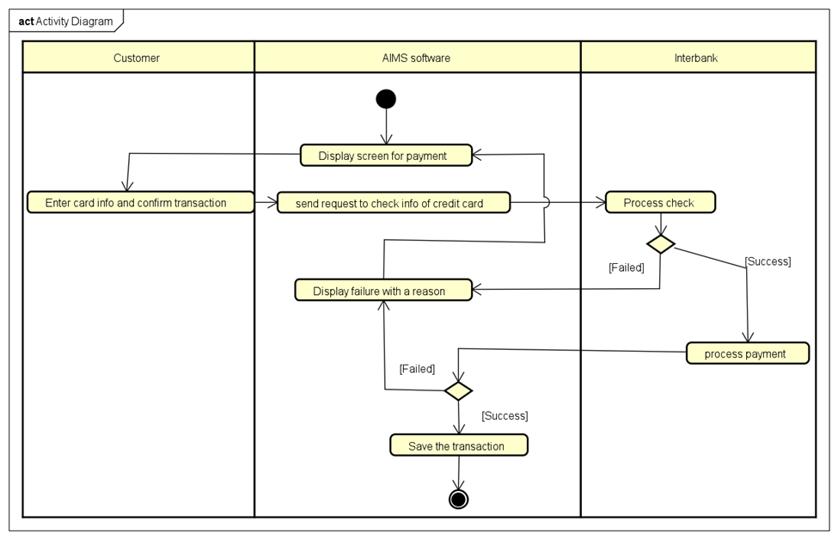
SYSTEM ARCHITECTURE & ARCHITECTURE DESIGN
2. Interaction Diagram:
d) Pay order

Slide 11
SYSTEM ARCHITECTURE & ARCHITECTURE DESIGN
2. Interaction Diagram:
e) Cancel order

Slide 12
DETAILED DESIGN
User Interface design
Screen Configuration Standardization
Display
Number of Colors Supported: 16,777,216 colors
Resolution: 1326 × 788 pixels
Screen Layout
Message Location: From the top vertically, centered horizontally, down to the bottom.
Title Display: Located at the top left of the frame.
Alphanumeric Consistency: Comma for thousand separators; strings include characters, digits, commas, dots, spaces, underscores, and hyphens.
Text Control
Size: Medium (24px)
Font: Segoe UI
Color: #000000

Slide 13
DETAILED DESIGN
User Interface design
Screen Configuration Standardization
Input Control
Input Check Process:
Check if empty
Validate format
Focus Sequence:
No stack frames; screens are separate.
Manual as popup; main screen inactive when manual shown.
Starts with splash screen, then home screen.
Navigation
Direct Keyboard Input: No shortcuts
Back Navigation: Back buttons for previous screen; close button (“X”) at the top right.
Error Handling
Error Messages: Notify users of the problem.

Slide 14
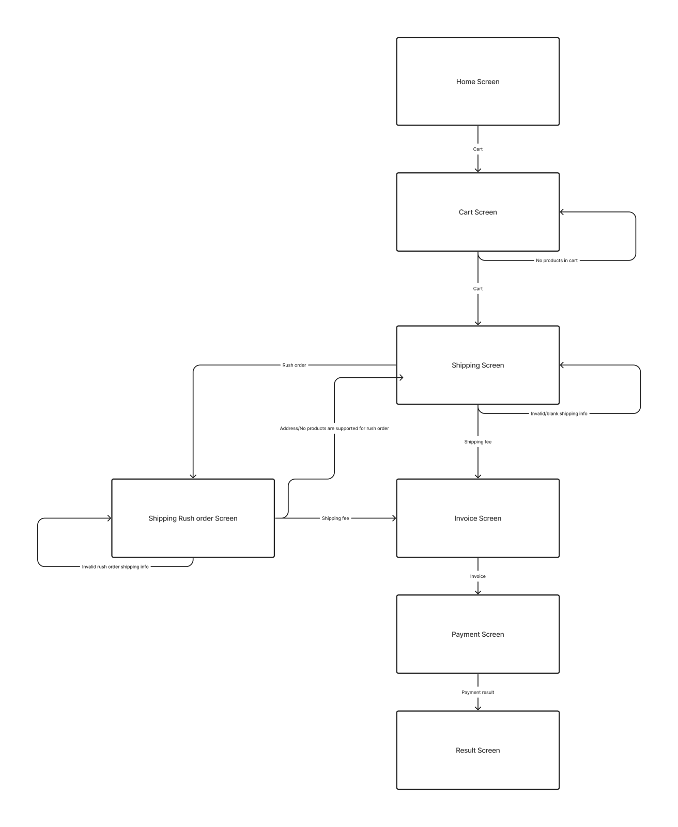
DETAILED DESIGN
User Interface design
b) Screen Transition
Diagrams

Slide 15
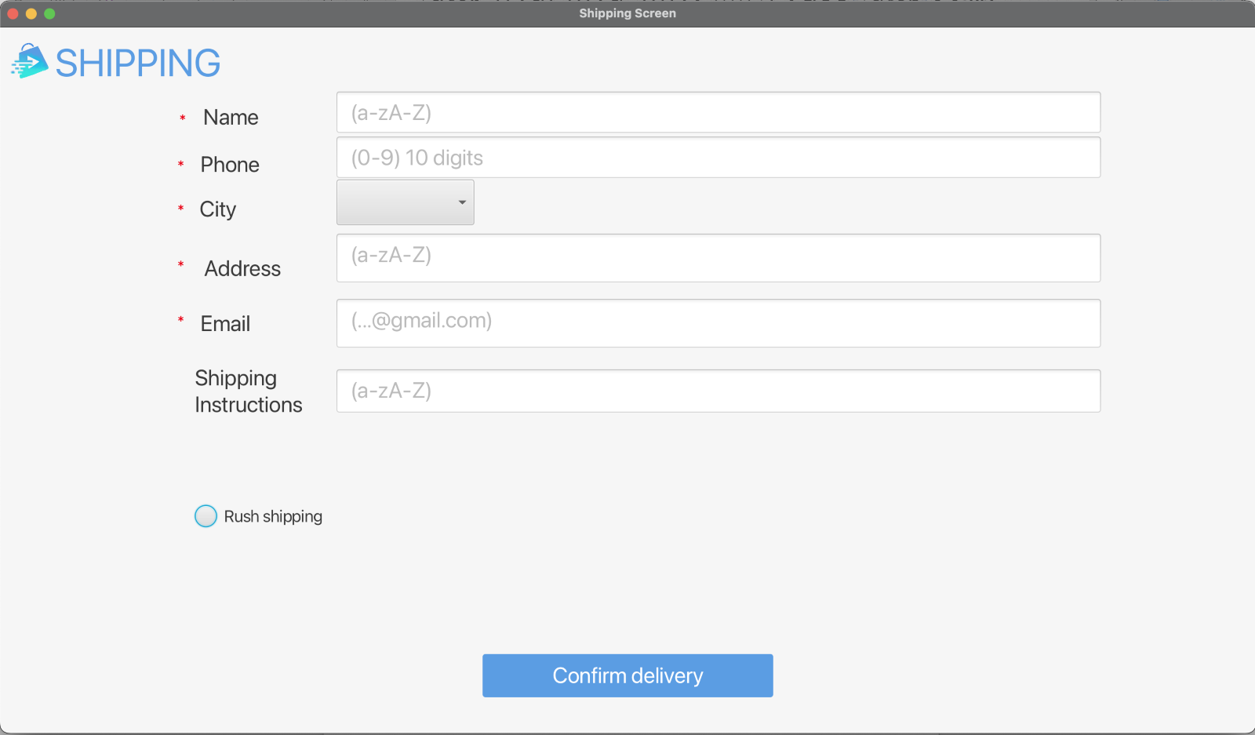
DETAILED DESIGN
User Interface design
c) Screen Specifications
Shipping Screen

Slide 16
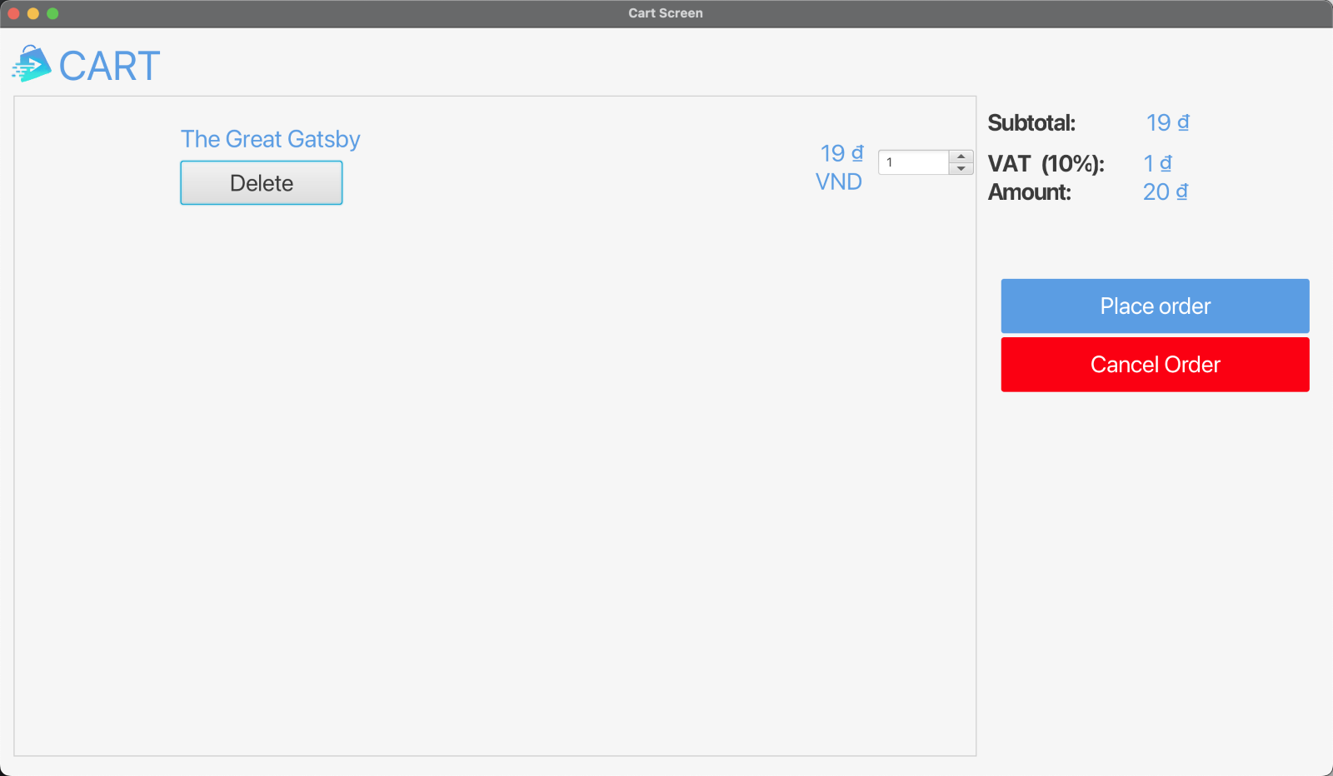
DETAILED DESIGN
User Interface design
c) Screen Specifications
Cart Screen

Slide 17
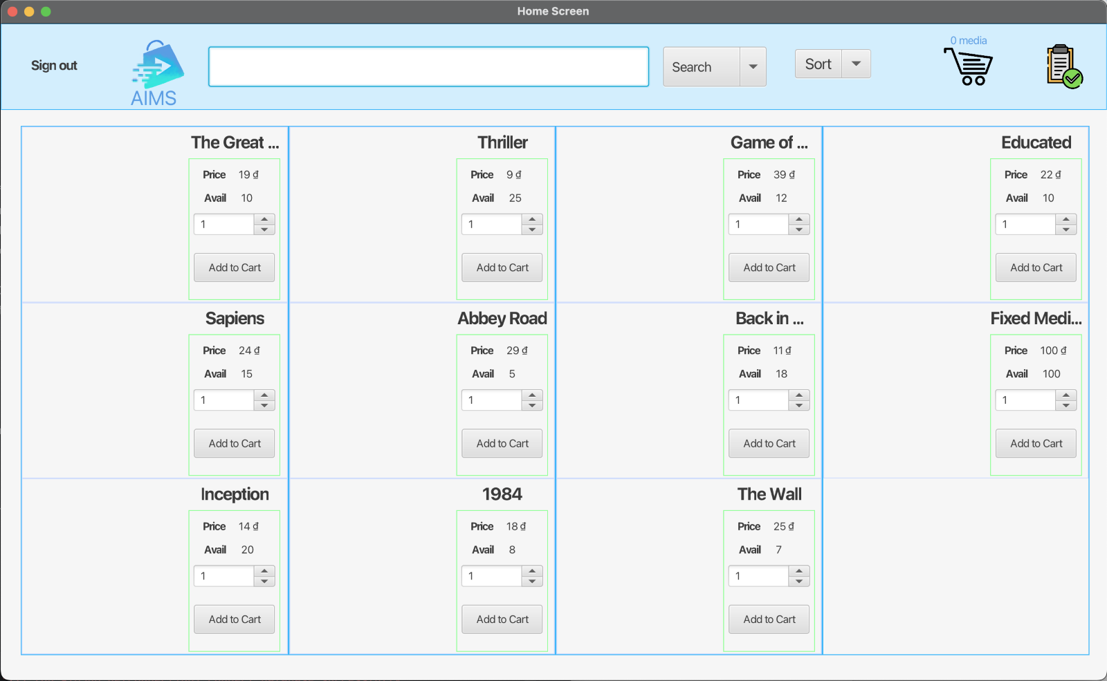
DETAILED DESIGN
User Interface design
c) Screen Specifications
Home Screen

Slide 18
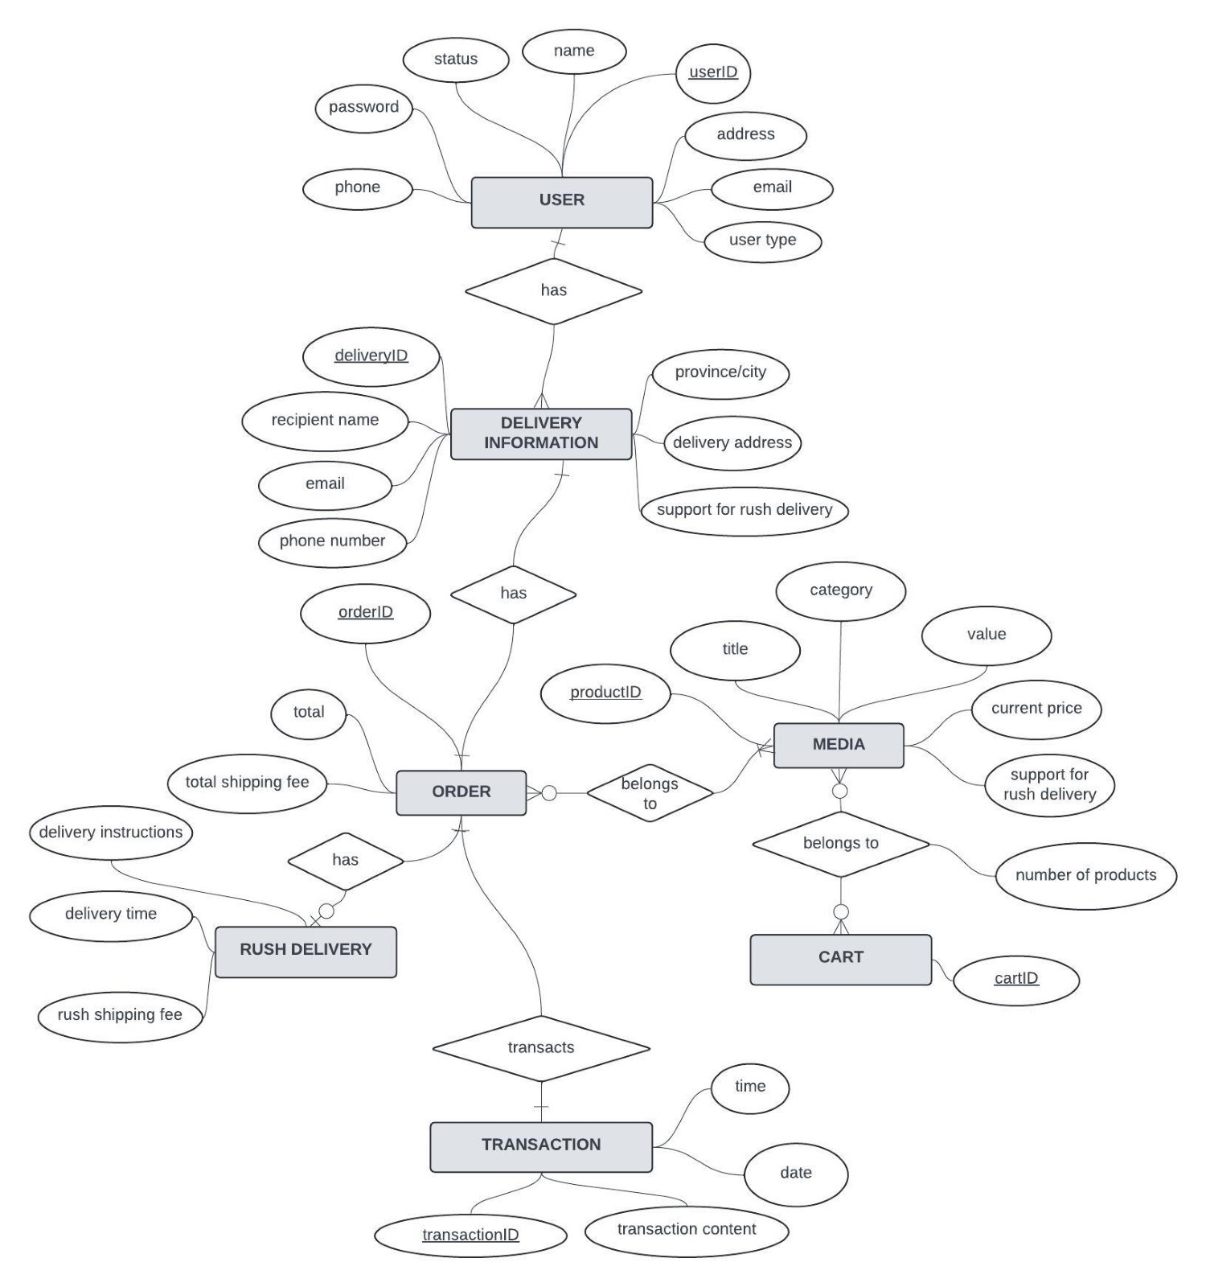
DETAILED DESIGN
2. Data Modeling
Conceptual Data Modeling

Slide 19
DETAILED DESIGN
2. Database Design
b) Database Design
Database Management System
SQLite for Project DBMS
Type: Lightweight, file-based RDBMS
Serverless: No server process
Zero Configuration: Ready out of the box
Transactional: Fully ACID-compliant
Lightweight: Small memory footprint
Cross-platform: Windows, macOS, Linux, iOS, Android
Self-contained: Single file storage
SQL Support: Subset of SQL standard
Interfaces: APIs for C, C++, Java, Python, etc.
Public Domain: Open-source
Concurrency: Supports multiple processes/threads

Slide 20
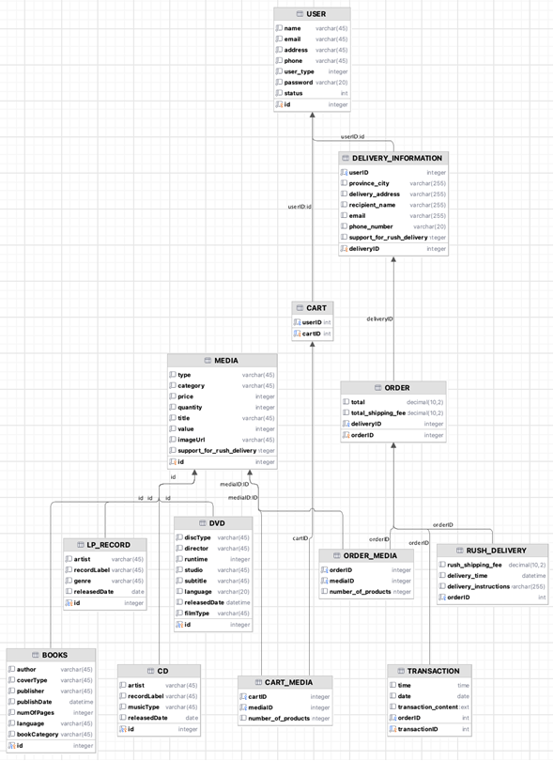
DETAILED DESIGN
2. Database Design
b) Database Design
Database Diagram

Slide 21
DETAILED DESIGN
2. Database Design
d) Class Design
General Class Diagram

Slide 22
DETAILED DESIGN
2. Database Design
d) Class Design
Class Diagrams

Slide 23
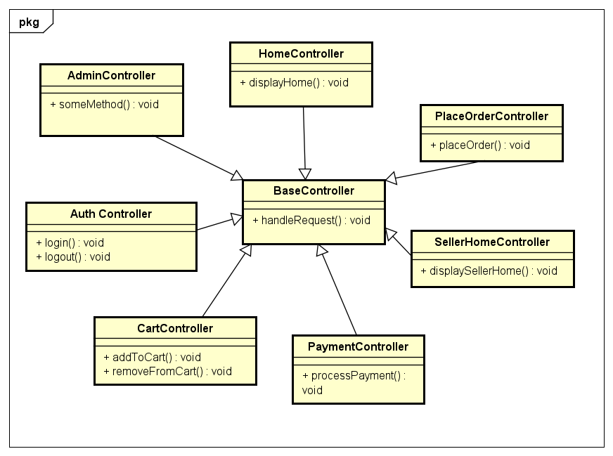
DETAILED DESIGN
2. Database Design
d) Class Design
Class Diagrams
+ Class Diagram for Package Controller

Slide 24
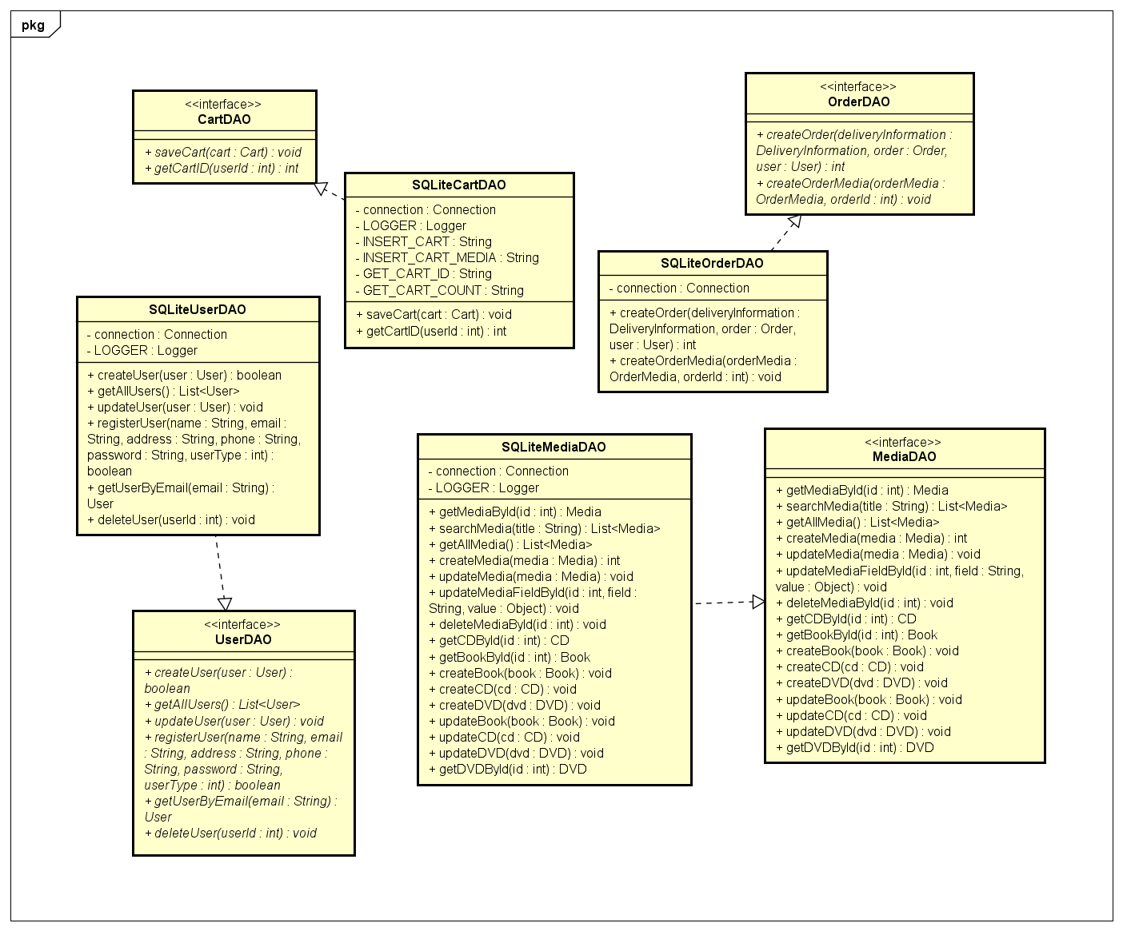
DETAILED DESIGN
2. Database Design
d) Class Design
Class Diagrams
+ Class Diagram
for Package DAO

Slide 25
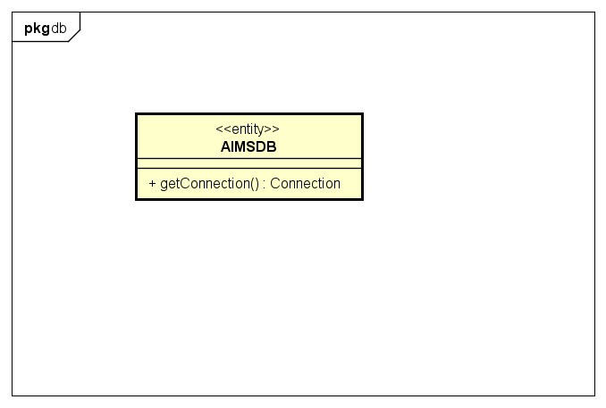
DETAILED DESIGN
2. Database Design
d) Class Design
Class Diagrams
+ Class Diagram for Package db

Slide 26
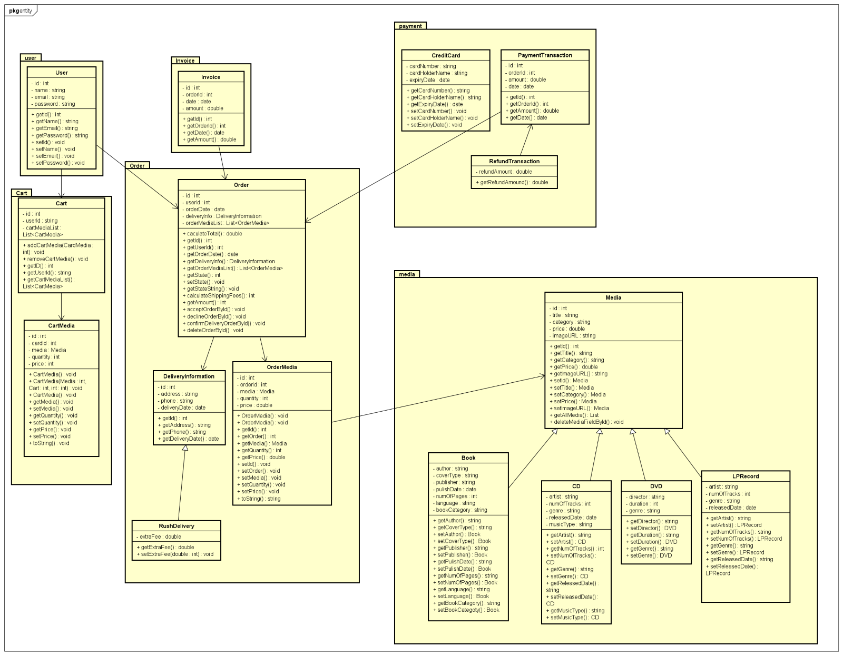
DETAILED DESIGN
2. Database Design
d) Class Design
Class Diagrams
+ Class Diagram
for Package Entity

Slide 27
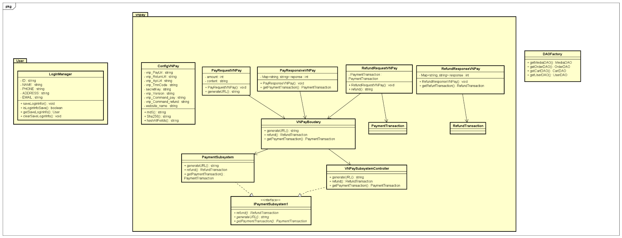
DETAILED DESIGN
2. Database Design
d) Class Design
Class Diagrams
+ Class Diagram for Package Services

Slide 28
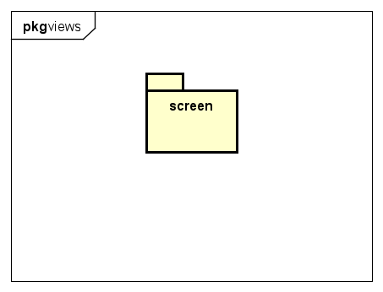
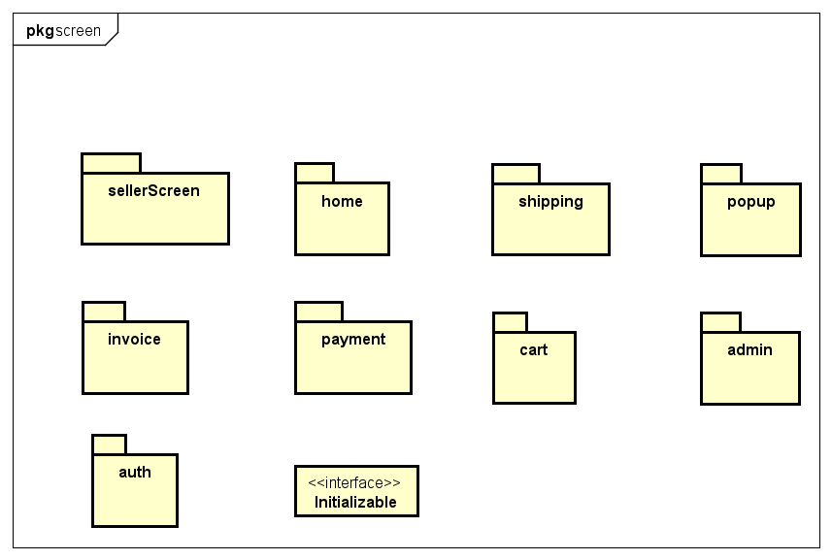
DETAILED DESIGN
2. Database Design
d) Class Design
Class Diagrams
+ Class Diagram for Package Views

Slide 29
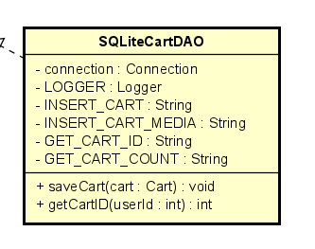
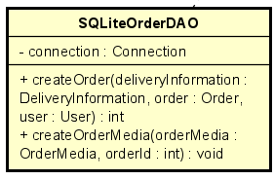
DETAILED DESIGN
2. Database Design
d) Class Design
Class Design ( for example)

Slide 30
DESIGN CONSIDERATIONS
Goals and guidelines
Goals
Performance: Emphasis on speed and responsiveness over memory use. This is essential to ensure a smooth user experience.
Usability: The software should have an intuitive user interface, closely resembling existing successful products in the same domain to reduce the learning curve for users.
Scalability: The system must be designed to handle increased loads and data volumes without significant performance degradation.
Maintainability: The source code should be easily understandable, modifiable, and extensible to accommodate future changes and enhancements.

Slide 31
DESIGN CONSIDERATIONS
Goals and guidelines
b) Guidelines
Coding Conventions: Adhere to consistent coding styles, including naming conventions, indentation, and comments, to improve readability and maintainability. For example, using CamelCase for class names and methods, and snake_case for variable names.
Error Handling: Implement comprehensive error handling to manage exceptions gracefully and provide meaningful feedback to the user.

Slide 32
DESIGN CONSIDERATIONS
Goals and guidelines
c) Design Policies and Tatics
Modular Design: Break down the system into smaller, manageable modules, each responsible for a specific functionality. This modular approach aids in isolating and resolving issues, as well as facilitating code reuse.
Interface Design: Use interfaces to define contracts for modules, promoting loose coupling and enhancing flexibility in swapping implementations.
Version Control: Employ a robust version control system (e.g., Git) to track changes, manage branches, and facilitate collaboration among developers.

Slide 33
DESIGN CONSIDERATIONS
2. Architectural Strategies

Slide 34
DESIGN CONSIDERATION
3. Coupling and Cohesion
Most Controller classes have functional cohesion and stamp coupling. Except for HomeController, which have logical cohesion and stamp coupling
The classes in the “Utils” package have very low level of cohesion (Coincidental cohesion) and very high level of coupling.
Entity classes have high level of cohesion - Communicational cohesion. Also, they have stamp coupling
Improvements in Handlers classes to make it functional coupling instead of stamp coupling.

Slide 35
DESIGN PRINCIPLES
Single responsibility principle
Most classes adhere to the Single Responsibility Principle.
Improvement in PlaceOrderController so that it also adheres SRP. (Create a DeliveryValidateInfo class for managing the validation of information)
Open/Closed Principle
In enity/media, getAllMedia(), getMediaById(), updateMediaFieldById() will be affected if we use other DBMS -> Use DAO class responsible for accessing data

Slide 36
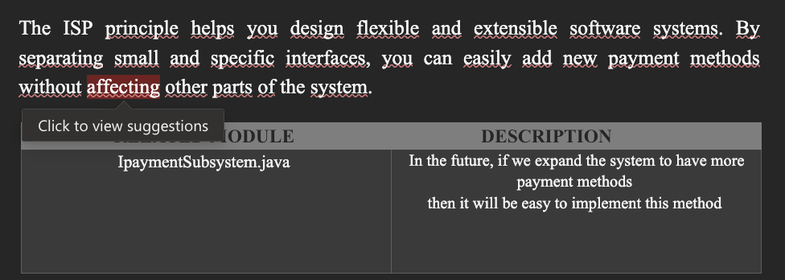
DESIGN PRINCIPLES
3. Interface segregation principle

Slide 37
DESIGN PATTERNS
DAO pattern: Used to separate data access logic from business logic, promoting loose coupling and single responsibility.
Singleton pattern: Some objects that exist only once in a session of the software (AIMSDB, LOGGER) are designed according to the Singleton design pattern.

Slide 38
THANK YOU !

